Slide 1
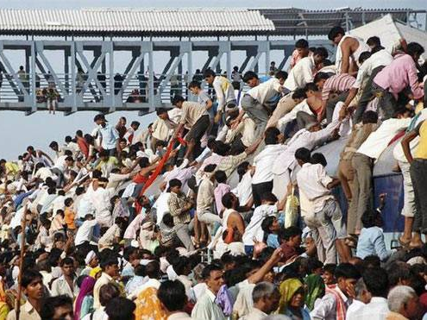
BES166 ► HRD: Today’s Topics
Census
Edu. Policy 2016
Health-Women, Children
HDI-2015 | SDG

Slide 2

BES166 ► HRD ► Education & Youth
Before Independence
After Independence
KG, Admission, Language, Fail
Higher Edu: Politics, mushroom
HRM
Youth Org (YB)

Slide 3
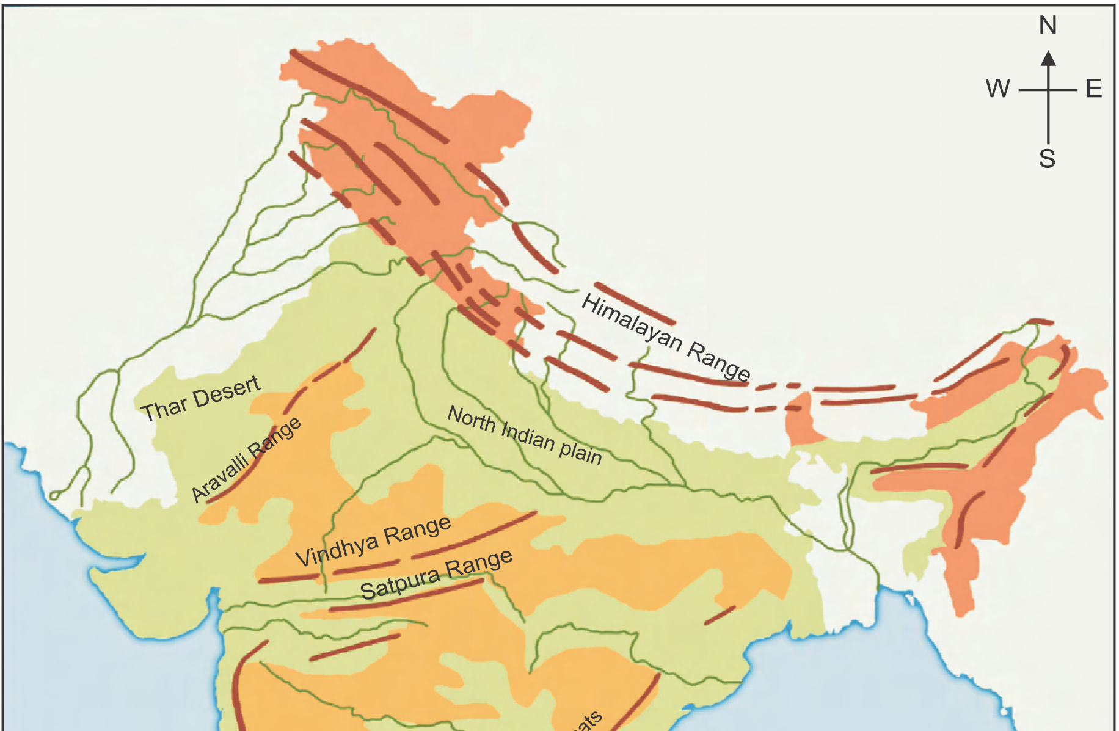
700BC: Takshshila-World’s 1st Uni.: Gandhar, Punjabi Pak.
Famous students
Chanakya (Pub.Ad)
Charak (BAMS)
Panini (BA, Sank.grammar)

Slide 4
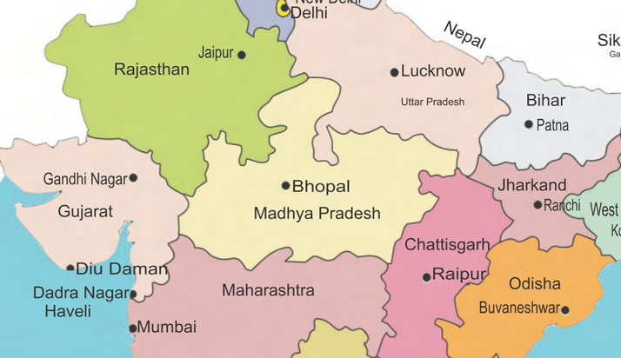
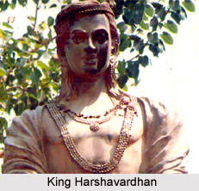

4th cent, BC: Magadh;
Nalanda= “Giver of knowledge”
Founder-Kumargupta
Valabhi, gulf of Cambay
Nalanda Mahavira: Mahayana
Valabhi: Hinyana
Notes:
world's first university was established in Takshila in 700 BC. The University of Nalanda, or the Nalanda Mahavira as it was known at the time, established in 4th century BCE, was one of the world’s first great universities in the world. In its heyday, in the 7th century AD, Nalanda University had some 10,000 students and 2,000 teachers.

Slide 5
Education in British India
Ch.10 Spectrum: development of Education
Charter 1813: Rs.1lakh
Bentinck ► Macaulay compulsory English
Dalhousie ► Woods’ dispatch: school, college, Uni@3 presidencies
Saddler comm., Uni. act
Who setup which deshi college?

Slide 6
BES166 ► HRD ► Education Policy
Before Independence
After Independence
KG, Admission, Language, Fail
Higher Edu: Politics, mushrooming
HRM

Slide 7
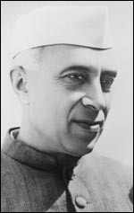
Education: Free India
Kendriya Vidhalaya, IIT, UGC
1968: NEP-I
10+2+3
3 language formula
1986: NEP-II
IGNOU; Jawahar Navoday: bright rural kids via entrance
1976: 42nd Amendment
Edu: State list ► Concurrent
PV updated in 1992

Slide 8
Education: Free India
2002: 86th Amendment
21A: Free, compulsory edu.- 6-14 by *LAW*
51A: parents/guardian- fundamental duty
2009: Right to Education act
45: DPSP- state shall early childhood upto 6 years
25% reservation to EWS in pvt. Schools=fake
Mushrooming infra without students.
No retention policy upto class8 = dumb kids
SSA (2001/02), MDM (2004 / 1995), Kasturba Balika – residential upper primary for weaker section
RMSA: Madhyamik

Slide 9
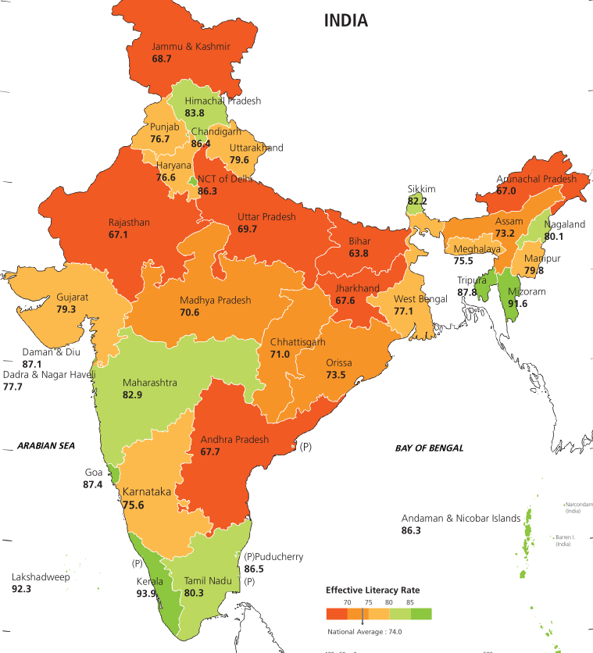
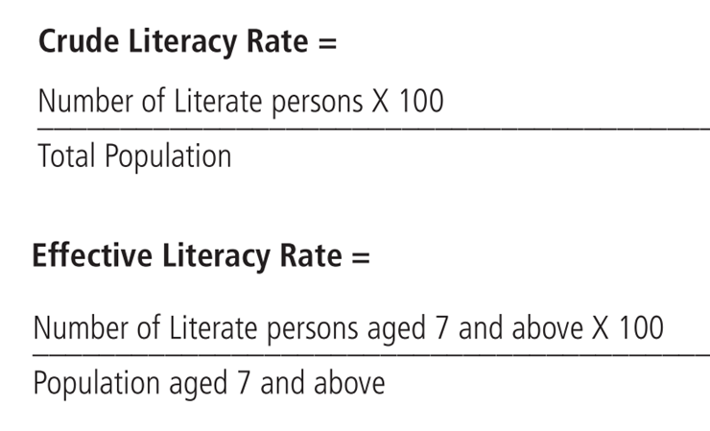
Highest
Lowest
Kerala: 94%
Lakshadweep: 92%
D&N: 76%
Bihar: 62%

Slide 10



(Draft) NEP-2016: observations
Largest illiterates in World
28 cr. (Age 7 and above)
Edu as GDP: 3.5% ► 6%; FDI, CSR, philanthropy
Notes:
Gross Enrolment Ratio in higher education remains low at 23.6 percent in 2014-15. The current target is to increase GER to 25.2 per cent in 2017-18 and further to 30 per cent in 2020-21
India currently has the largest non-literate population in the world with the absolute number of non-literates among population aged 7 and above being 282.6 million in 2011.
India also hosts the largest number of youth and adult illiterates in the world with the youth literacy rate (15-24 years) and adult literacy rate (15 years and above) in India in 2011 being 86.1 percent and 69.3 percent respectively.

Slide 11
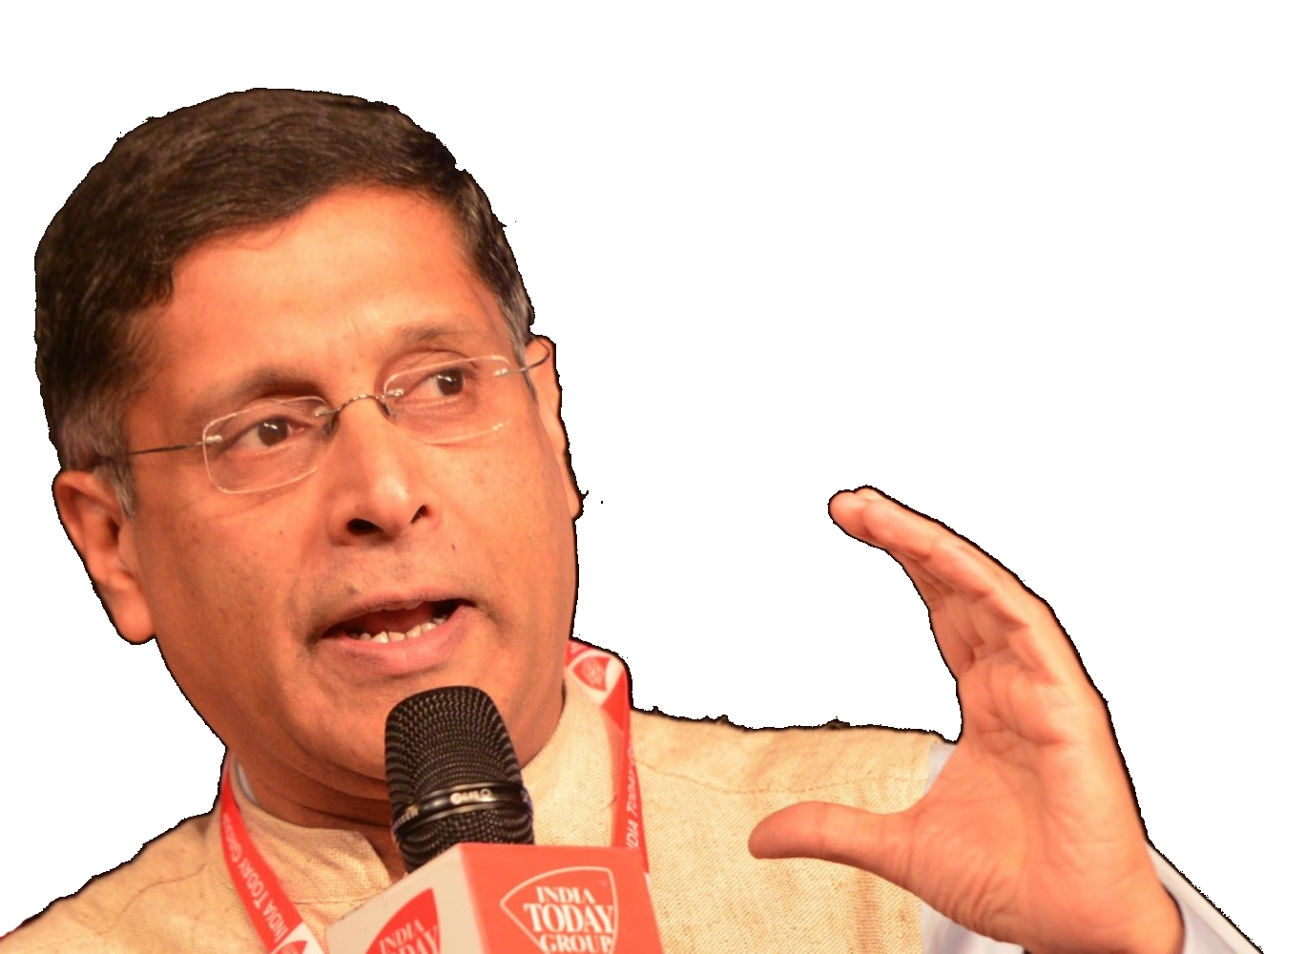
Demographic transition in schools
Primary: 5-9
Upper Primary: 10-14
Higher edu. 15-29
Enrollment ▼
Enrollment ▲
But dropout rate also high
Gender disparity high
This transition started earlier in South India, due to declining fertility rates – so focus more on vocational skill
Notes:
This lag in demographic transition among states in India could turn out to be a great blessing from the point of view of coping with the problem of declining population.
s. Thus states already well into the demographic window should actively pursue policies for employment generation to the already bulging labour force, while states just entering the window period have some time to plan and must pursue policies simultaneously in several areas like education, health (including reproductive health), gender issues, and employment generation from now on so that they can fully utilize the opportunity.

Slide 12
Modi- various schemes
Skill
Nai Manzil: Madress passout to mainstream
USTAAD: minorities craft
DD- Antyodaya Yojana
Pradhan Mantri Kaushual Vikas
Education
Madan Mohan Malviya: teachers’ training
BBBP, sukanya samridhi click me
Vocational

Slide 13
Literacy
62 new Navoday Vidhyalaya
Digital literacy:
National Digital Literacy Mission;
Digital Saksharta Abhiyan (DISHA)
Target: 6 cr. Rural households in next 3 years.
Budget 2016

Slide 14
BES166 ► HRD ► Education Policy
Before Independence
After Independence
KG, Admission, Language, Fail
Higher Edu: Politics, mushrooming
HRM
2015: TSR Subramanian
Former cabinet secy
Green law panel chief
Edu. Comittee (HRD)

Slide 15

Kindergarten
Draft NEP-2016
children aged 4-5 years
Learning and development readiness for primary education
Anganwadi /ICDS: restructure’em.
Notes:
Expanding early childhood education services to ensure that all pre-school age attain the learning and developmental readiness required for smooth transition to primary education,
Ensuring that at all youth and at least 90% of adults, both men and women, achieve literacy and numeracy skills prescribed by the adult education programmes;
Anganwadis under the ICDS are not adequately equipped to provide pre-school education.
curricula and develop learning materials, within a year, and provide training to Anganwadi workers.
Kendriya Vidyalayas (KVs) and Jawahar Navodaya Vidyalayas (JNVs) will be expanded and Kasturba Gandhi Balika Vidyalayas (KGBVs) will be expanded and upgraded,

Slide 16

School Admission
Draft NEP-2016
Art 30/1: minority to setup edu. Inst.
RTE 2009: Section 12/1/c: 25% free seats to EWS in Private unaided schools.
2014: Pramati judgement- RTE N/A on Minority inst.
Policy- will examine if 25% EWS in Government-aided minority schools?
Notes:
RTE Act not applicable to minority schools, rules Supreme Court
2014

Slide 17

NEP-2016: Language up to class-5
Primary
2nd language
As State desires
3rd language
Within Constitution
English, if state desires
Mother tongue (Art. 350-A)
Notes:
Language
All states and UTs, if they so desire, may provide education in schools, upto Class V, in mother tongue, local or regional language as the medium of instruction.
Therefore, if the medium of instruction upto primary level is the mother tongue or local or regional language, the second language will be English and the choice of the third language (at the upper primary and secondary levels) will be with the individual states and local authorities, in keeping with the Constitutional provisions.

Slide 18
NGO Pratham: ASER report for 2014
~20%
Class2 kids who can’t identify numbers upto 9 (d
48%
Class5 kids who can read class2 text (u
6%
25%
Class3 kids can solve 2 digit subtraction (d
Schools without toilets (d
56%
Schools with separate toilets for girls (u
49%
Pupil:teacher ratio (u
3.3%
Rural kids not enrolled (same)
Classroom : teacher ratio
73
71%
Kids attendance (d
57%
Schools have 2 classes running in same room. (u
(u= up or improved than last year
(d= down or decreased than last year

Slide 19
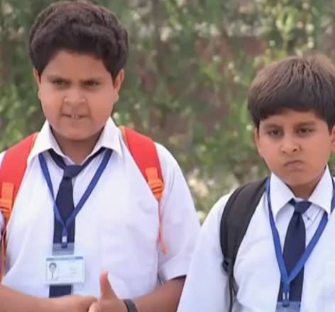
PISA report since 2000 every 3 years
OECD
Programme for International Student Assessment
Maths, Sci, Reading test for 15 y.o.
Top players: Shanghai-China; Singapore..
India did not participate in PISA 2012, 2015- socio-cultural disconnect in Test-Qs
Notes:
फिर भारत समज गया की खुद अपनी फजीहत नही करवानी है.
38: Russia
72: Tamilnadu
73: HP
74: Kyrgyzstan (LAST one)

Slide 20
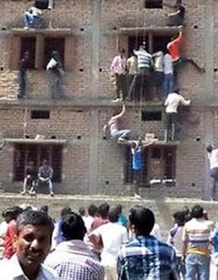
RTE problem: No detention policy
Section (18)
no failure till class 8- because repeat class is demotivating and discouraging ► Dropout rate ▲
Section 29(h)
continuous and comprehensive evaluation CCE
enforced since 2010.
individual assessment by teachers ► don’t have time; training
Powerpoint, projects ► copied from internet / buddies
Solution: Padhe Bharat -Badhe Bharat
addl. Classes for maths, comprehension
Attendance: teacher-95%, student-75%, 30:1 ratio ;

Slide 21
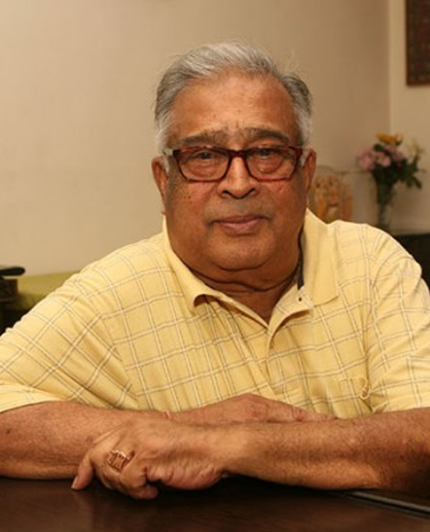
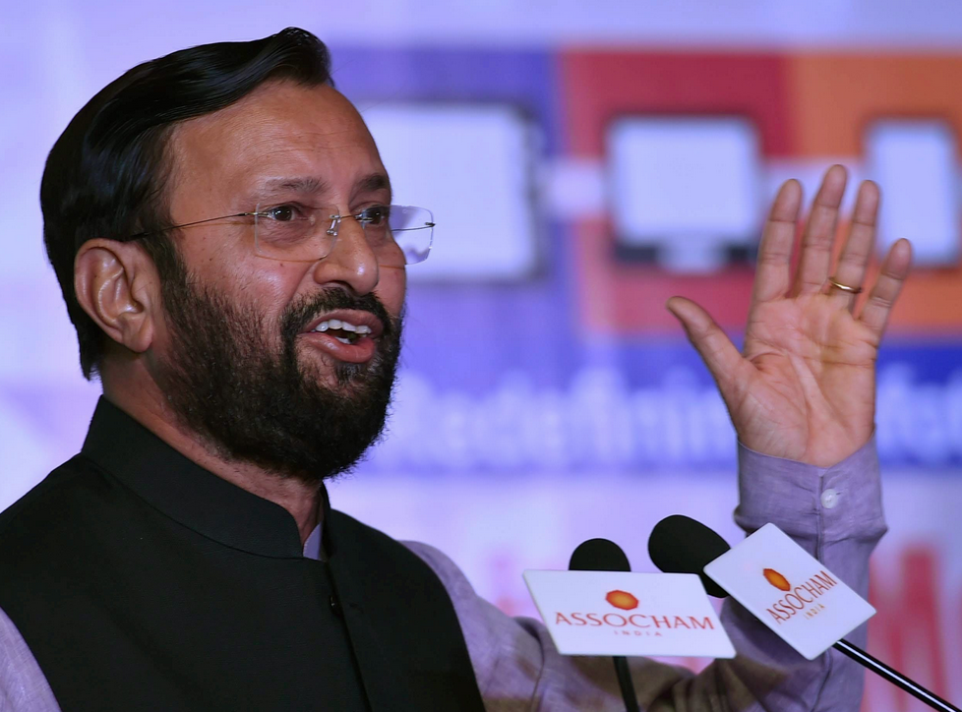
No Retention Policy
TSR committee
No detention policy till Class8.
But promotion to class-9 will be conditional- based on Min. std. of academic performance (MSAP)
Draft education Policy
Min. standards will be laid down on student “outcomes”
Notes:
HRD ministry- Indian rankings for higher education framework.
No detention policy till Class8. But promotion to class-9 will be conditional- based on Min. std. of academic performance (MSAP)
NITI says allow foreign universities with a separate law.

Slide 22
RG/DD Class-10 aaraam se pass krlo yojana
Class-10 high failure rate in Maths, Science, English
Part-A tough if u want pursue higher edu.
Part-B: easy, if u want to take vocational stream.
Class-10 and 12
central exam /Percentile/scaling. So students don’t suffer in college admission
Notes:
High failure rate in class-X examination is attributed to a large extent to poor performance in three subjects: Mathematics, Science and English. In order to reduce the failure rates, class X examination in Mathematics, Science and English will be at two levels: Part-A at a higher level and Part-B at a lower level. Students who intend to join courses/ programmes for which science, mathematics or English is not a prerequisite or wish to shift to vocational stream after class-X will be able to opt for Part-B level examination.
Scaling is one alternative. Some other alternatives are conducting a central examination at the end of class-X and XII, or, expressing the scores in terms of percentile in each Board.

Slide 23

Adult literacy
Draft NEP-2016
National Literacy Mission (NLM), Saakshar Bharat Abhiyan,…
28 crore illiterates.
Target: 90% adult literacy
Recognition of Prior Learning (RPL)
Notes:
National Fellowship Fund, primarily designed to support the tuition fees, learning materials and living expenses for about 10 lakh students will be created. The scholarships from this fund will be made available to students belonging to the economically weaker sections.
An emphasis on adult literacy was put for the first time on 2 nd October 1978 when the National Adult Education Programme (NAEP) was launched. In the last 40 years, a number of programmes have been started, such as, Rural Functional Literacy Programme (RFLP), National Literacy Mission (NLM), Saakshar Bharat Abhiyan, etc. Despite all these efforts, India still has over 280 million adult illiterates which is about one-third of the total number of adult illiterates in the world.
has been developed so far. To overcome this gap, the Government will, within a year, endeavour to develop a mechanism to assess and certify such skills and competencies and facilitate the entry of those who have no formal education and training but have acquired the skills without any certification for possession of those skills.

Slide 24
BES166 ► HRD ► Education Policy
Before Independence
After Independence
KG, Admission, Language, Fail
Higher Edu: Politics, mushroom
HRM

Slide 25
(Draft) NEP-2016: Targets

Slide 26
Higher education
Digital depository
LC, degree etc.
Store, retrieve, authenticate
10 public+10pvt inst : world class
New agency HEFA: Higher Education Financing Agency
1000 Crore via donation, CSR, market
Finance the infra upgrade in top institutions
Not for profit
Budget-2016

Slide 27

National Fellowship Fund
Edu. Policy 2016
tuition fees, learning materials and living expenses for about 10 lakh students from EWS
Notes:
An emphasis on adult literacy was put for the first time on 2 nd October 1978 when the National Adult Education Programme (NAEP) was launched. In the last 40 years, a number of programmes have been started, such as, Rural Functional Literacy Programme (RFLP), National Literacy Mission (NLM), Saakshar Bharat Abhiyan, etc. Despite all these efforts, India still has over 280 million adult illiterates which is about one-third of the total number of adult illiterates in the world.
has been developed so far. To overcome this gap, the Government will, within a year, endeavour to develop a mechanism to assess and certify such skills and competencies and facilitate the entry of those who have no formal education and training but have acquired the skills without any certification for possession of those skills.

Slide 28
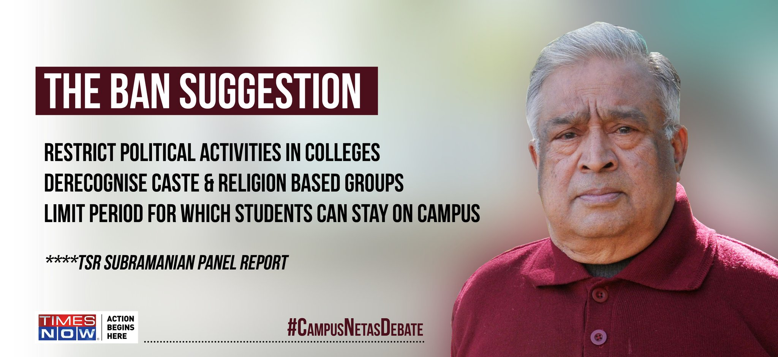
Lyngdoh Committee: Students' Union Elections In Colleges/Universities
Draft education Policy (HRD)
Study will be conducted
To Stop uncle-jis from playing active role/misusing hostel and other facilities
Notes:
A study will be conducted to prevent outsiders and those who have ceased to be students from playing an active role in students' politics and disrupting the academic activities as well as to prevent them from staying in hostels and misuse facilities of the institute.

Slide 29
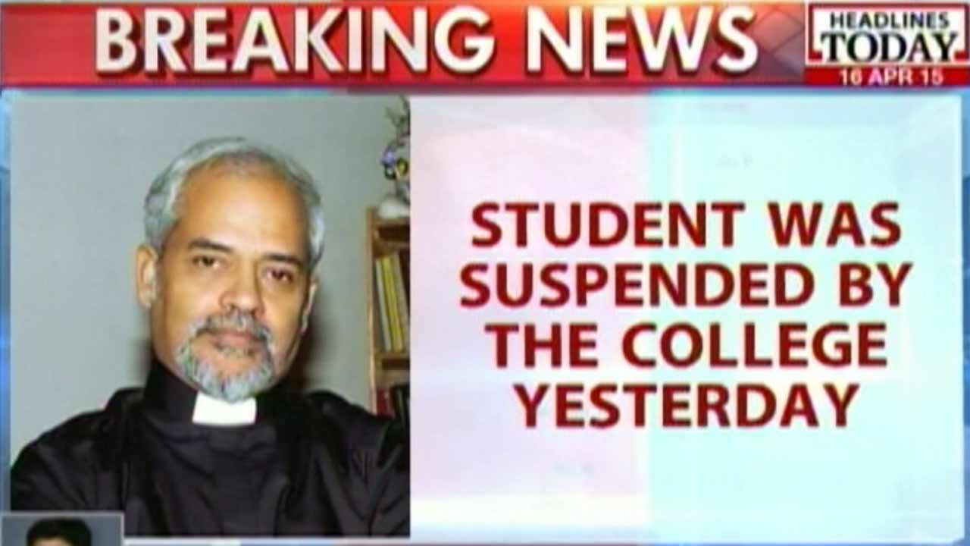
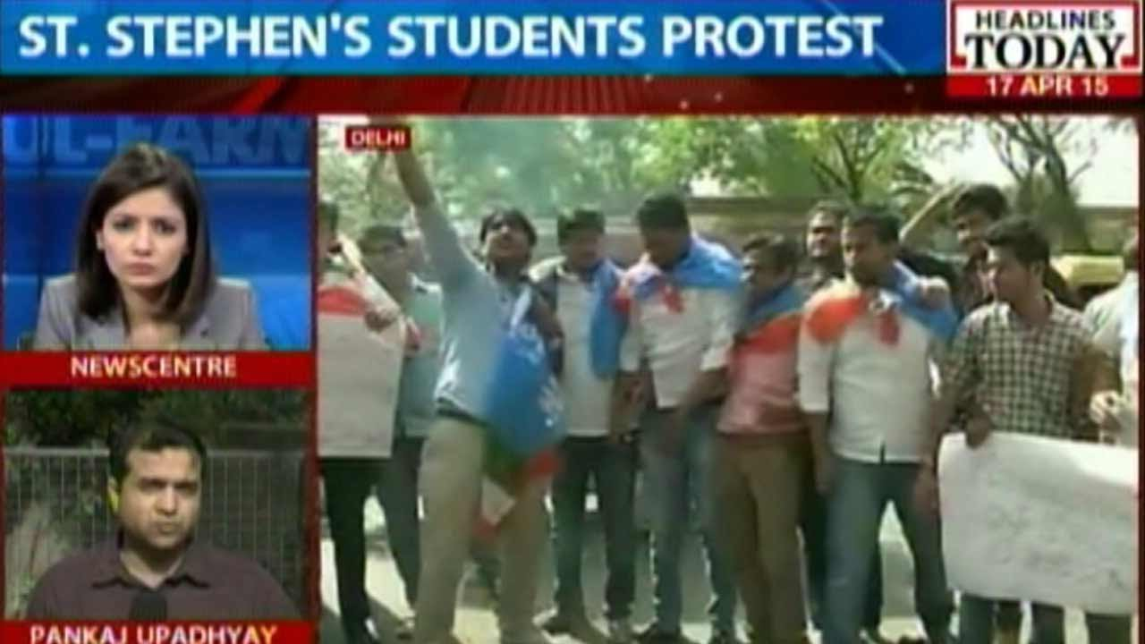

Slide 30
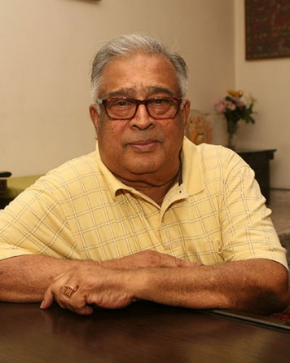
dispute / disciplinary action
Draft NEP-2016
Natural justice in punishment:-
mens rea: guilty mind- what was defendant thinking
audi alterem partem: listen to other side
Tribunals @union+State to handle grievances, under retired HC judges.
Notes:
Till the IES comes into existence, an interim step of a one-time special recruitment by UPSC from among the existing academic and administrative positions in the education sector in various states will be made in concurrence with the states.
Separate education tribunals will be established at the centre and in the states to deal with litigation and address public grievances against government as well as private schools/ institutions. These bodies will be headed by a retired High Court Judge.

Slide 31

Higher Education Quality control
Education Policy 2016
1 uni. can't have more than 100 affiliated colleges.
Central Educational Statistics Agency (CESA): GIS, stop mushrooming.
MHRD's National Institute Ranking Framework (NIRF); restructure NAAC etc.
compulsory website with transparency.

Slide 32
HEI: Distance learning, foreign univ.
Open Distance learning/MOOC
IGNOU, quality control
NIOS: vocational/skill Development
Intl. uni.
top-200 invite'em to India (NITI: separate law)
two-way street; update curriculum, Indian uni. can setup abroad
SWAYAM self-study portal

Slide 33
BES166 ► HRD ► Education Policy
Before Independence
After Independence
KG, Admission, Language, Fail
Higher Edu: Politics, mushroom
HRM

Slide 34


DRAFT-NEP-2016: HR/Recruitment
All India
Indian Education service (IES); HRD as cadre controlling
until that happens- one time recruitment by UPSC to absorb existing officials
with concurrence of states = cooperative fed.
State level
Teacher educator- separate cadre
Teachers
Local recruitment: absenteeism check via ICT
Notes:
for the creation of an Indian Education Service (IES), which is reiterated herein too. The IES will be an all India service with HRD as the cadre controlling authority.
IT-based applications will be used for monitoring teacher and student attendance,
A transparent and merit based norms and guidelines for recruitment of teachers will be formulated
For remote and difficult areas, efforts will be made to recruit the teachers locally.

Slide 35
Education Policy
Before Independence
After Independence
KG, Admission, Language, Fail
Higher Edu: Politics, mushroom
HRM
Youth Org (YB)

Slide 36
Policies
2013: Child Policy – below 18
2014: Youth policy – 15-29
2015: National policy for skill & entrepreneurship (ML3-PPT)
Notes:
“gender neutral definition in child!!”
National Youth Policy, 2014
Definition- 15-29
with about 65 per cent of the population being under 35 years of age.

Slide 37
Naukari.com
Online job portal: inter-link State Employment Exchanges with the National Career Service platform.
Budget-2016

Slide 38
Budget 2016
(existing) PM Kaushal Vikas Yojana: training+stipend+reward+loan
1500 New centres
1 cr. Youth in 3 years.
CRITICISM
Nearly 18 lakh trained but hardly 82,000 got placement.
Main reason: the trainees leave the program halfway.
Vocational

Slide 39

Yearbook ► Youth ► Organization
National Service Scheme (NSS)
Motto: “Not Me, But You”.
1972
Nehru Yuva Kendra Sangathan (NYKS)
2010
National Youth Corps (NYC): min. class-10 passout, 2.5k per month stipend; collector-Committee selects.
1948
National Cadet Corps (NCC) via Act; 15 lakh
Motto: ‘Unity and Discipline’.
1969
2015
“Ek Bharat Shreshtha Bharat”
Bilateral State exchange for 1 year; language, trade, culture, travel and tourism.
Notes:
2) The 'Ek Bharat Shreshtha Bharat' initiative will be launched soon under which every state will choose another state each year and then promote its language and culture.
3) The government has formed a committee to work out the modalities of the scheme in consultation with the states.
4) According to the scheme, two states will undertake a unique partnership for one year which would be marked by cultural and student exchanges.
5) Students of a particular state would travel to another state to learn each other's culture.

Slide 40

Youth ► Sports
1956
Maulana Abul Kalam Azad Trophy
Inter-University Tournaments- max. medal winner
1961
Arjuna Award The award
total 5 years consistent performance
1982
Sports welfare fund.
Assistance if <2 lakh annual income.
1984
Sports Authority of India (SAI)
reg. society, main purpose ASIAD Delhi stadium maintenance

Slide 41

Youth ► Sports
1985
Dronacharaya Award: coaching
1986
special award for winning intl. tournaments
e.g. Olympic gold medal: Rs.75 lakhs.
1991
Rajiv Gandhi Khel Ratna Award
₹ 7.5 lakh
2002
Dhyan Chand Award
Life Time Achievements in Sports
2014
Rajiv Gandhi Khel Abhiyan: sports infra @local level.
Notes:
Sports
1956
Maulana Abul Kalam Azad Trophy
Inter-University Tournaments- max. medal winner
1961
Arjuna Award The award
total 5 years consistent performance
1982
Sports welfare fund.
Assistance if <2 lakh annual income.
1984
Sports Authority of India (SAI)
reg. society, main purpose ASIAD Delhi stadum maintanance
1985
Dronacharaya Award: coaching
1986
special award for winning intl. tournaments
e.g. Olympic gold medal: Rs.75 lakhs.
1991
Rajiv Gandhi Khel Ratna Award
₹ 7.5 lakh
2002
Dhyan Chand Award
Life Time Achievements in Sports
2014
Rajiv Gandhi Khel Abhiyan: sports infra @local level.

Slide 42

BES166 ► HRD: Today’s Topics
Census
Edu & Youth
Health-Women, Children
HDI-2015 | SDG

